Slide 1
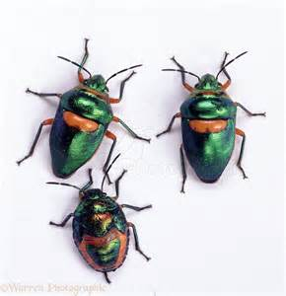
Debugging
CIS 399

Slide 2
Course Overview
Wk | Topic
1 | Intro + single-screen apps
1 | Activity Lifecycle +
1 | Saving activity state and more
2 | Menus + Themes
2 | Multi-screen apps + Fragments
Wk | Topic
3 | Reading XML files + Asynch Tasks
3 | List Views
3 | SQLite Database
4 | Consuming a web service
4 | Geolocation

Slide 3
Testing
Testing vs. Debugging

Slide 4
Four test phases

Slide 5
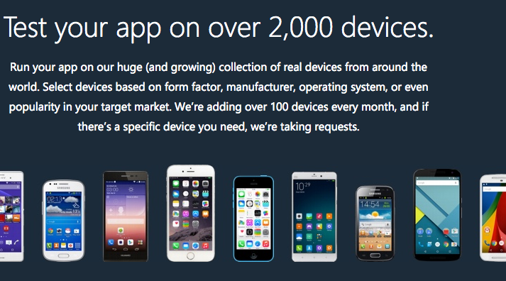
Xamarin Test Cloud
https://www.xamarin.com/test-cloud
Notes:
https://www.xamarin.com/test-cloud

Slide 6
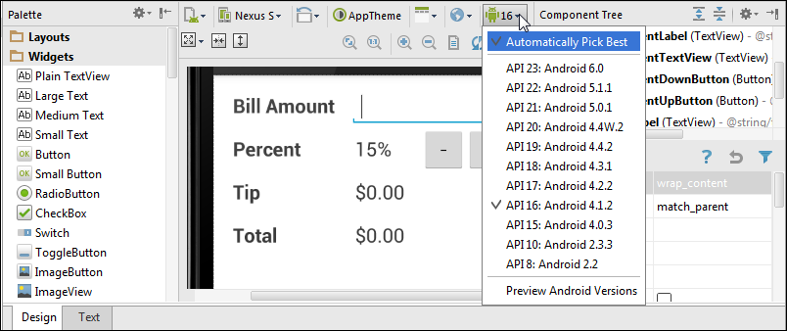
A layout in the graphical editor displayed by Android 4.1.2 (API 16)

Slide 7
How to check the layout

Slide 8
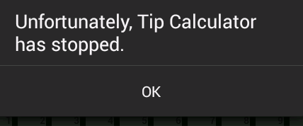
The error that’s displayed when an app crashes
Notes:
Run-time error

Slide 9
Debugging
Types of bugs:
Unhandled exceptions (aka: run-time error, crash)
Logical errors (wrong results)
Navigation
Data not saved

Slide 10
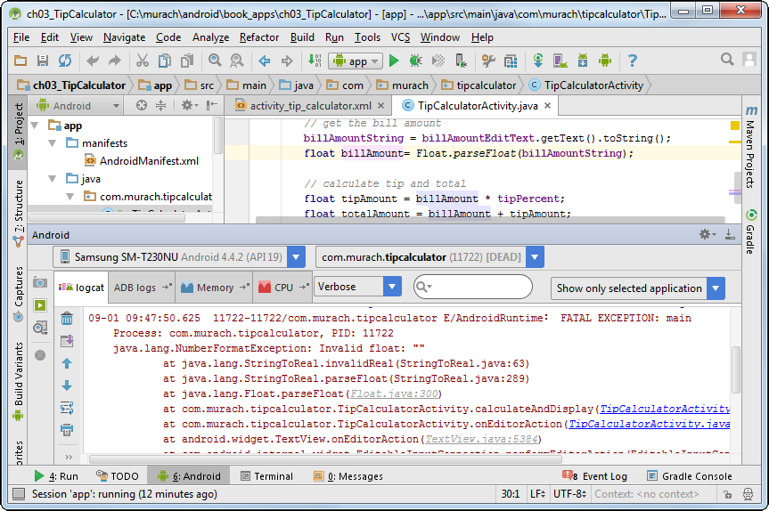
The LogCat view after a crash

Slide 11
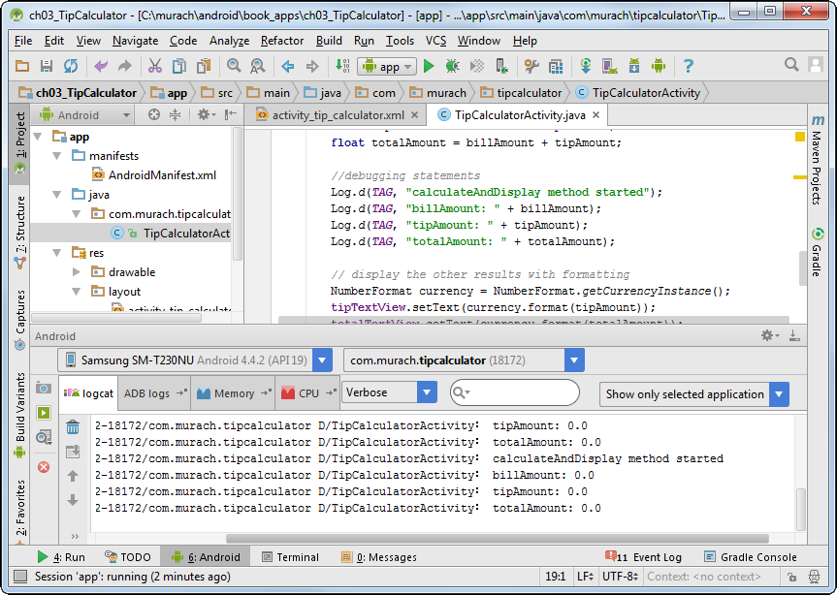
Android Studio with the LogCat window displayed

Slide 12
Send Your Own Messages to LogCat
Import the class import android.util.Log
Declare a constant for the tag parameter private static final String TIP_CALC = “TipCalculatorActivity”;
Send messages to the log Log.d(TIP_CALC, “In editor event”);
A few methods of the Log class

Slide 13
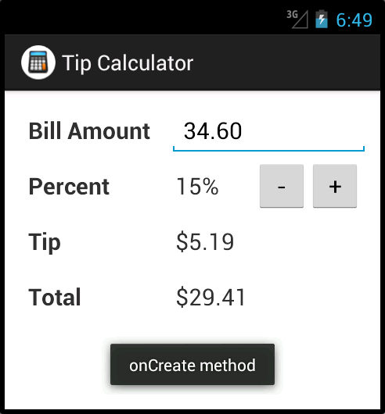
A toast displayed in an emulator

Slide 14
Two methods of the Toast class

Slide 15
How to display a toast

Slide 16
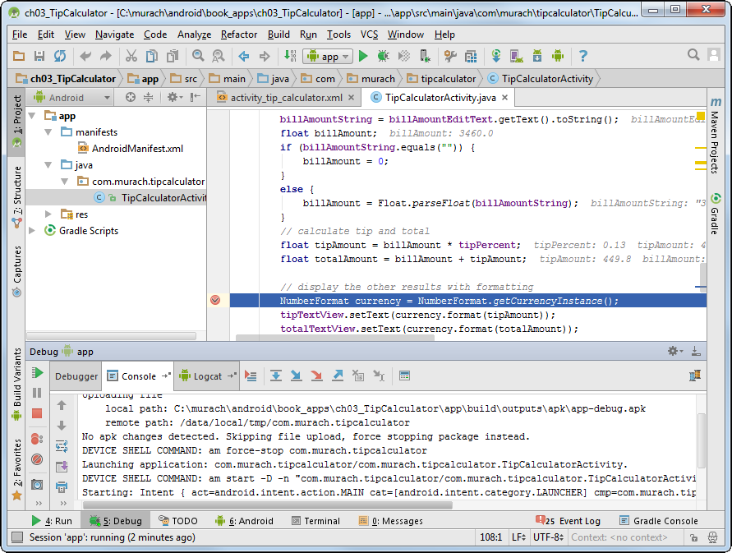
The Java code with a breakpoint

Slide 17
How to set and remove breakpoints

Slide 18
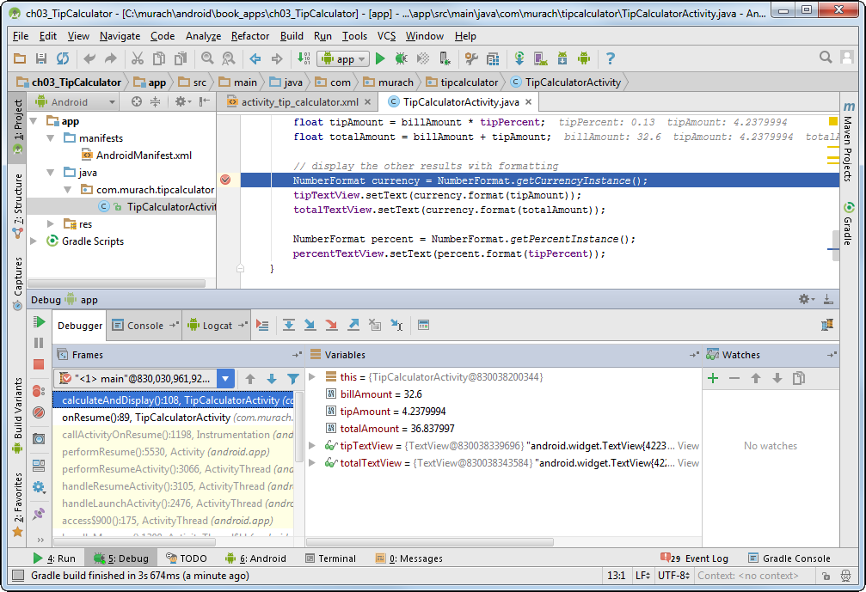
The Debug window

Slide 19
How to work with the Debug window

